Slide 1


6.12.2022

Slide 2
Transitions Accelerated Progress Plan (APP)
12 month plan to make rapid, significant and meaningful improvement felt by children, young people and their families in transition
  Developed after our local area SEND revisit in February found we had not made “sufficient progress” in multi-agency transitions for children and young people with SEND – with most criticism relating to post 16, post 18 and beyond.
  Monitored by DfE and NHSE.
  The first six months is around putting changes in place and includes a six-month review. The second is about making sure the changes are having a positive impact, are embedded and will be sustainable.
The plan involves all services working together
  Education, health, and care services are committed to working together at pace to improve transitions for young people.
  We want to work with children, young people, their parents, carers, and the organisations that represent them (such as Sheffield Parent Carer Forum), to co-produce as much as possible and make changes that have the most benefit.
Not forgetting other areas/Continuing to improve in other areas
  We know there are other areas of SEND that also need improvement, including those found to have made "sufficient progress" in the recent local area inspection revisit. We continue to work on these at pace.

Slide 3
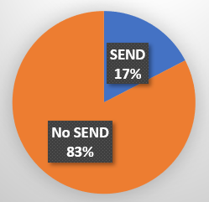
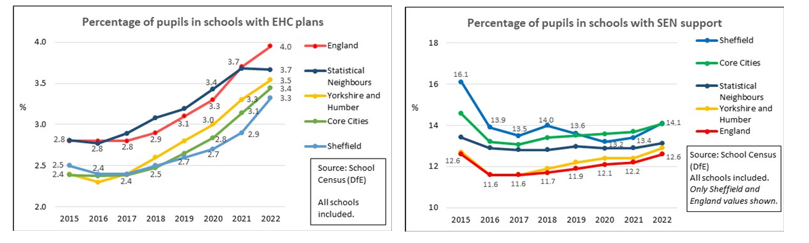
Our children and young people
In Sheffield 17.4% of pupils (14,500) have an EHC Plan or receive SEN support.
      We maintain 4,459 EHCPs (end of Oct). This is up from 3,997 in Jan 22 – a 12% increase.
12%
The ethnicity of children with or without SEND in Sheffield state schools is:
ECHP and SEN support comparison/ trends
Sheffield is below national for EHCP, and above for SEN support
For both, Sheffield and Core Cities track fairly closely

Slide 4
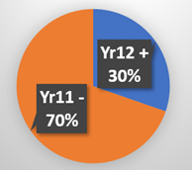
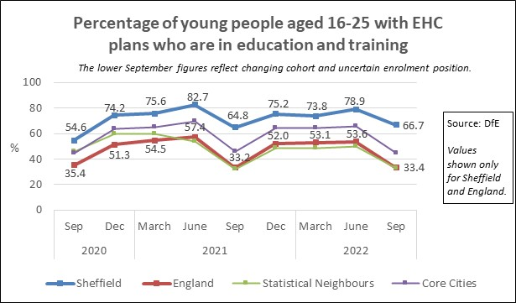
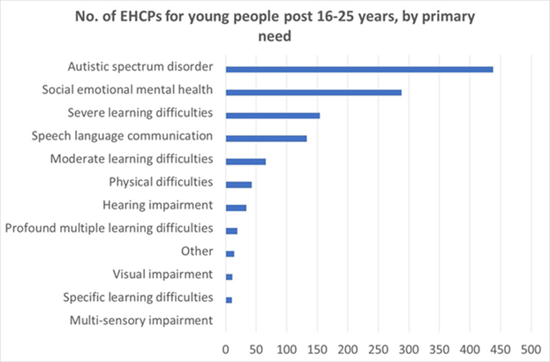
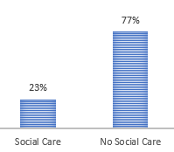
Our children and young people (cont’d).
Almost a third of EHCPs (1,335) - are for young people in Year 12 and above, aged 15/16 to 25 years old.
Two thirds of these young people are in Education, Employment or Training.
  EET figures (across the country) are always low in September, reflecting the tracking / cohort position at this point in the year.
The Sheffield College is our largest post 16 provider (approx. 400 students with EHCPs), followed by Sheaf Training (approx. 145).
23% of the 16 to 17 year olds with an EHCP are open to children’s social care.
Most prevalent primary needs are ASD, then SEMH

Slide 5
APP Governance structure
Inclusion Improvement Board
Learn Sheffield and school partnership meetings
SEND Transitions Group
1. Preparation for Adulthood workstream
2. Post 16 opportunities workstream
3. Transition processes workstream
4. Co-production, communication & information workstream
5. Multi-agency staff development
Workstream
Co-production will run through all workstreams. It will be coordinated through workstream 4.
All workstreams will work to Sheffield’s Co-production Charter and Transition Principles.
We have school/college representation in workstreams 1/5 and 2, and always welcome more across the APP.

Slide 6
The Workstreams
Preparation for Adulthood - ensuring preparation for adulthood discussions begin at the earliest opportunity across the local area, leading to an earlier identification of need and improved support at key transition points.
Post 16 opportunities - developing a shared and improved understanding of post 16 opportunities and gaps and creating new opportunities.
Transition processes- ensuring children and young people have a positive transition experience through strong partnership working.
Co-production, communication and information - co-producing new and improved information, advice and guidance, and ensuring this is communicated to ensure that CYPF and across EHC understand the transition pathways and post 16 opportunities.
Multi-agency staff development – developing and implementing a multi-agency training and development plan reflecting the outcomes of a skill gap analysis.

Slide 7
Selection of activity so far…
Increasing engagement with young people - inc. setting up a new SEND Advisory Group for young people aged 13 – 25.
Significant audit activity to understand Preparation for Adulthood (PFA) practice in EHCPs and annual reviews – combined with feedback from children, young people, families and professionals.
  Key feedback related to confidence and understanding of PFA, the four areas that need to be considered within this, awareness and availability of opportunities, and the child or young person’s voice.
Development of training and tools to support preparation for adulthood:
Preparation for Adulthood: What it is, the four areas to consider, and conversation prompts
Changes to paperwork – EHCP and annual review paperwork and new guide (coming soon) and Extended Support Plan (book training here)
247 grid training (book training here)
SEND the basics – coming soon

Slide 8
Selection of activity so far – cont.
More training coming soon - Preparation for Adulthood training from NDTI (National Development Team for Inclusion):
28 April 2023 – Preparation for Adulthood training for special schools working with young people 16-19 years old.
12 May 2023 – PfA training for primary and secondary schools, and the careers hub.
Further opportunities are being planned with NDTI.
Improving opportunities and information about them:
  Increasing employer engagement.
  Increased activity to support young people with SEND who are NEET.
  Multi-agency work to look at post 16 opportunities and gaps.
  Student summits.
  Information for families – pop-up information events and SPCF events.
  Information is being improved on Sheffield’s new Local Offer website, the Transitions Guide is being updated, and pathway information is being improved.

Slide 9
Selection of activity so far – cont.
Social care transitions:
  Significant investment in social care transitions teams capacity, including a new adults transitions team (investment before the APP).
Progress:
  Close working relationship between children’s and adult social care transition teams - a ‘reach across’ approach means young people are known to adult social care earlier.
  We are now working with young people at age 16. We anticipate being able to work with young people from age 14 (Year 9) onwards from March 2023.
  We are now identifying some young people who were not previously known to Children with Disabilities Team.
  Please can special schools and IRs send their lists of EHCP annual reviews and dates for young people who may go onto adult social care.

Slide 10
Summary of APP progress
All areas in the plan are making progress but we have more to do to make sure improvements are achieved on a sustained and large scale.
BRAG rating | No. of APP actions & targets | % of APP actions & targets
 | 4 | 10%
 | 7 | 17.5%
 | 29 | 72.5%
 | 0 | 0%
Total | 40 | 100%
BRAG ratings:
Blue complete, sustained and demonstrable on large scale
Green complete/achieved but not yet sustained and/or not on a large scale yet
Amber making progress but not achieved milestone
Red not making any progress and failed milestone

Slide 11
Ask of schools and settings
Please book onto the new training and development opportunities, and encourage others to – this is about embedding Preparation for Adulthood at all ages and stages.
  www.learnsheffield.co.uk/Partners/Inclusion-Task-Force/Training
Special schools and IRs – please send the list of EHCP annual reviews and dates as early as possible to the social care transitions teams for young people who may go onto adult social care..
Talk to your pupils and families about taking up Annual Health Checks and why they are so important. Annual Health Checks for Young People with Learning Disabilities | Sheffield (sheffielddirectory.org.uk)
Encourage your pupils to join the new SEND Advisory Group and/or one of our youth clubs. (Two are specifically for young people with SEND)
  youth.services@sheffield.gov.uk
Share information with your students and families. This includes about the new Local Offer website (further improvement work taking place)
  www.sheffielddirectory.org.uk/localoffer

Slide 12

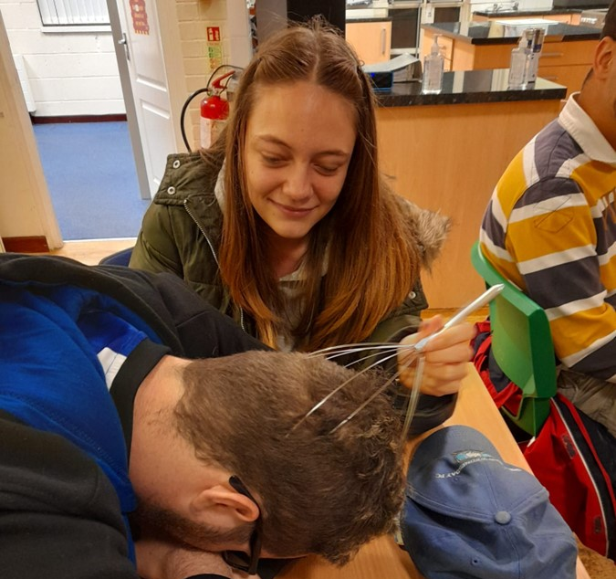
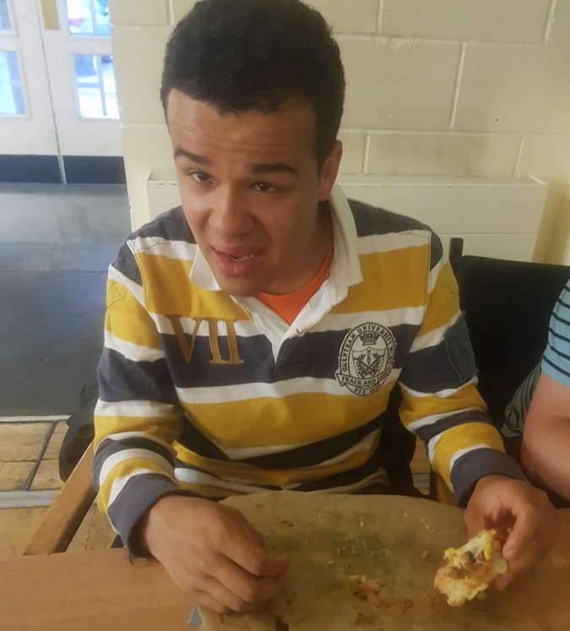
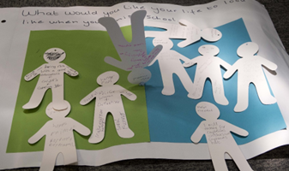
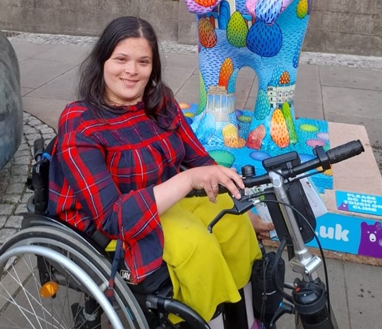
Next steps and further information
Next steps:
  Continued delivery of the Accelerated Progress Plan.
  Development of a longer-term SEND transitions improvement plan – this is a later action in the APP and will be developed through coproduction and engagement.
Further information:
  Sheffield’s Accelerated Progress Plan is available online at www.sheffield.gov.uk/sendinspection
  For more information please contact Kate Hughes, Business Change Lead for the Accelerated Progress Plan, kate.hughes@sheffield.gov.uk

